Slide 1
m;0;;;
Mordor

Slide 2
mission notes
General Note
2022-03-21
Watch out for RingWraiths
Notes:
Watch out for RingWraiths c;0;;;;2022-03-21T02:45:00.772Z Paul 2022-03-21

Slide 3
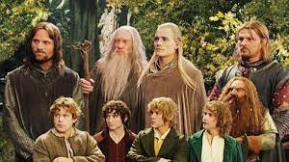
mission notes
Nursing Note
2022-03-21
Concil at Rivendel
Notes:
Concil at Rivendel c;0;;;;2022-03-21T02:45:00.746Z Paul 2022-03-21

Slide 4
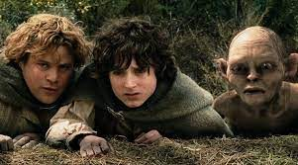
mission notes
General Note
2022-03-21
One of these is not like the others
Notes:
One of these is not like the others c;0;;;;2022-03-21T02:45:21.807Z Paul 2022-03-21

Slide 5
mission notes
General Note
2022-06-25
Notes:
c;0;;;;2022-06-25T02:18:46.625Z Hobbit 2022-06-25

Slide 6
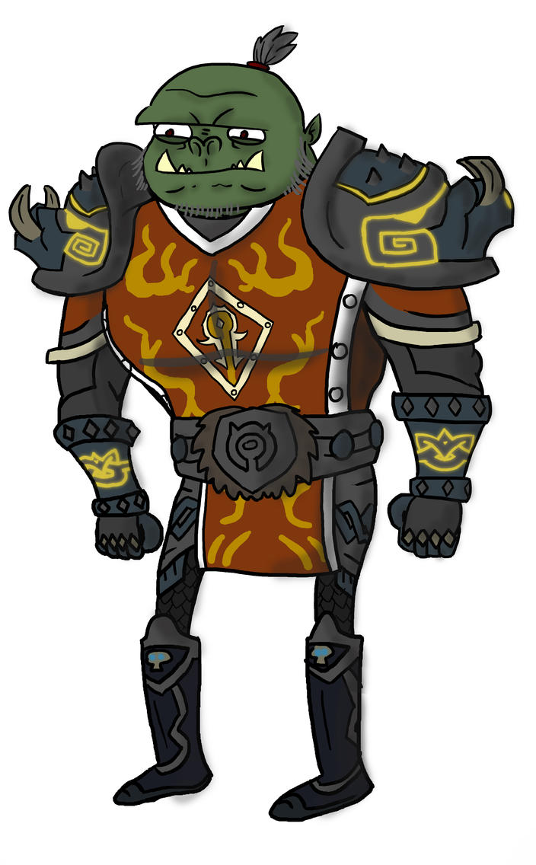
mission notes
General Note
2023-10-09
Introduction:
In the aftermath of the epic battles that took place in Middle Earth, a coalition of skilled medical professionals from our world embarked on a noble and challenging mission to aid in the recovery and healing of the war-torn land. This surgical mission to Middle Earth was a testament to the boundless compassion and commitment of the medical community to help those in need, regardless of the realm.
Mission Objectives:
Assessment and Triage: The first step of the mission involved assessing the extent of injuries and determining the critical cases that required immediate attention. Triage units were set up in various regions to categorize patients based on the severity of their injuries.
Emergency Medical Care: Surgical teams, equipped with advanced medical technology and supplies, provided emergency medical care to stabilize wounded individuals. This included treating wounds, setting broken bones, and addressing life-threatening conditions.
Reconstruction Surgery: For individuals with severe injuries, including amputations and disfigurements, specialized surgical teams were tasked with performing complex reconstructive surgeries. This was done to restore functionality and improve the quality of life for those affected.
Prosthetic and Rehabilitation Services: Patients who had lost limbs were fitted with state-of-the-art prosthetic devices, custom-designed to suit their needs. Rehabilitation programs were established to help patients regain mobility and adapt to their new prosthetic limbs.
Mental Health Support: Recognizing the profound psychological trauma endured by the inhabitants of Middle Earth during the war, a team of mental health professionals was deployed to provide counseling and support services to those suffering from PTSD and other mental health issues.
Public Health Initiatives: In addition to direct medical care, the mission included public health campaigns to address sanitation, hygiene, and disease prevention. Vaccination programs and education on hygiene practices were implemented to improve the overall health of the population.
Challenges:
Cultural Sensitivity: The medical teams needed to be culturally sensitive and respectful of the customs and beliefs of Middle Earth's inhabitants, ensuring that their interventions were well-received and understood.
Logistics: Operating in a fantastical realm presented logistical challenges, including adapting medical equipment to a different environment and ensuring a stable supply chain for essential medical resources.
Language Barrier: Communication with the locals, who spoke various languages, required skilled interpreters and the development of a common medical terminology.
Security: Despite the war's end, remnants of unrest and conflict posed security risks to the medical teams, necessitating the deployment of security personnel to ensure their safety.
Impact:
The surgical mission to Middle Earth had a profound and lasting impact on the region. It not only saved lives and restored physical and mental well-being but also fostered goodwill between the inhabitants of Middle Earth and our world. As a symbol of hope and healing, the mission served as a testament to the power of compassion and cooperation across realms, transcending the boundaries of fiction and reality. The legacy of this mission continues to inspire collaborative efforts to address crises and promote peace in both Middle Earth and our own world.
Notes:
Introduction: In the aftermath of the epic battles that took place in Middle Earth, a coalition of skilled medical professionals from our world embarked on a noble and challenging mission to aid in the recovery and healing of the war-torn land. This surgical mission to Middle Earth was a testament to the boundless compassion and commitment of the medical community to help those in need, regardless of the realm. Mission Objectives: Assessment and Triage: The first step of the mission involved assessing the extent of injuries and determining the critical cases that required immediate attention. Triage units were set up in various regions to categorize patients based on the severity of their injuries. Emergency Medical Care: Surgical teams, equipped with advanced medical technology and supplies, provided emergency medical care to stabilize wounded individuals. This included treating wounds, setting broken bones, and addressing life-threatening conditions. Reconstruction Surgery: For individuals with severe injuries, including amputations and disfigurements, specialized surgical teams were tasked with performing complex reconstructive surgeries. This was done to restore functionality and improve the quality of life for those affected. Prosthetic and Rehabilitation Services: Patients who had lost limbs were fitted with state-of-the-art prosthetic devices, custom-designed to suit their needs. Rehabilitation programs were established to help patients regain mobility and adapt to their new prosthetic limbs. Mental Health Support: Recognizing the profound psychological trauma endured by the inhabitants of Middle Earth during the war, a team of mental health professionals was deployed to provide counseling and support services to those suffering from PTSD and other mental health issues. Public Health Initiatives: In addition to direct medical care, the mission included public health campaigns to address sanitation, hygiene, and disease prevention. Vaccination programs and education on hygiene practices were implemented to improve the overall health of the population. Challenges: Cultural Sensitivity: The medical teams needed to be culturally sensitive and respectful of the customs and beliefs of Middle Earth's inhabitants, ensuring that their interventions were well-received and understood. Logistics: Operating in a fantastical realm presented logistical challenges, including adapting medical equipment to a different environment and ensuring a stable supply chain for essential medical resources. Language Barrier: Communication with the locals, who spoke various languages, required skilled interpreters and the development of a common medical terminology. Security: Despite the war's end, remnants of unrest and conflict posed security risks to the medical teams, necessitating the deployment of security personnel to ensure their safety. Impact: The surgical mission to Middle Earth had a profound and lasting impact on the region. It not only saved lives and restored physical and mental well-being but also fostered goodwill between the inhabitants of Middle Earth and our world. As a symbol of hope and healing, the mission served as a testament to the power of compassion and cooperation across realms, transcending the boundaries of fiction and reality. The legacy of this mission continues to inspire collaborative efforts to address crises and promote peace in both Middle Earth and our own world. c;0;;;;2023-10-09T16:22:55.877Z Hobbit 2023-10-09

Slide 7
Bilbo Baggins
DOB: | 2022-03-17
Height:
Weight:
Sex:
Meds:
Allergies:
Notes:
p;0;Baggins;Bilbo;2022-03-17 Paul

Slide 8
Bilbo Baggins
General Note
2022-03-03
Hero of The Hobbit
Notes:
Hero of The Hobbit c;0;Baggins;Bilbo;2022-03-17;2022-03-03T18:49:06.614Z Paul 2022-03-03

Slide 9
Bilbo Baggins
General Note
2022-03-12
paul write this note. Not too clever.
Notes:
paul write this note. Not too clever. c;0;Baggins;Bilbo;2022-03-17;2022-03-12T02:18:26.646Z Paul 2022-03-12

Slide 10
Bilbo Baggins
Anesthesia Note
2023-10-10
Certainly! When anesthetizing a hobbit, hypothetical approaches based on general anesthesia principles could include:
1. Inhalation Anesthesia: An inhalation anesthetic, such as a gas or vapor, can be used to induce and maintain anesthesia. It could be administered using a specialized mask or chamber designed to fit the size of a hobbit's face.
2. Intravenous Anesthesia: An intravenous anesthetic agent can be administered through a small catheter inserted into a hobbit's vein. This would require establishing venous access with the appropriate-sized needle and administering the anesthetic medication slowly.
3. Local Anesthesia: For minor procedures, numbness can be achieved by injecting a localized anesthetic medication directly into the area needing anesthesia.
4. Pre-operative Evaluation: Prior to administering anesthesia, a comprehensive pre-operative evaluation is crucial to assess a hobbit's medical history, allergies, and any other considerations that may affect the choice and administration of anesthesia.
Please remember that this response is based on a fictional scenario and does not provide direct instructions for anesthesia administration in real-life situations.
Notes:
Certainly! When anesthetizing a hobbit, hypothetical approaches based on general anesthesia principles could include: 1. Inhalation Anesthesia: An inhalation anesthetic, such as a gas or vapor, can be used to induce and maintain anesthesia. It could be administered using a specialized mask or chamber designed to fit the size of a hobbit's face. 2. Intravenous Anesthesia: An intravenous anesthetic agent can be administered through a small catheter inserted into a hobbit's vein. This would require establishing venous access with the appropriate-sized needle and administering the anesthetic medication slowly. 3. Local Anesthesia: For minor procedures, numbness can be achieved by injecting a localized anesthetic medication directly into the area needing anesthesia. 4. Pre-operative Evaluation: Prior to administering anesthesia, a comprehensive pre-operative evaluation is crucial to assess a hobbit's medical history, allergies, and any other considerations that may affect the choice and administration of anesthesia. Please remember that this response is based on a fictional scenario and does not provide direct instructions for anesthesia administration in real-life situations. c;0;Baggins;Bilbo;2022-03-17;2023-10-10T17:41:46.823Z Hobbit 2023-10-10

Slide 11
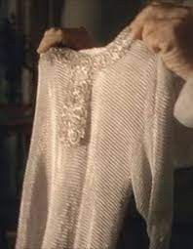
Frodo Baggins
General Note
2023-05-16
Mithril tunic
Notes:
Mithril tunic c;0;Baggins;Bilbo;2022-03-17;2023-05-16T08:58:28.425Z Hobbit 2023-05-16

Slide 12
Frodo Baggins
DOB: | 2022-03-01
Height: | 3 ft
Weight: | 4 stone
Sex: | M
Meds:
Allergies: | Ring Wraithes
Notes:
p;0;Baggins;Frodo;2022-03-01 Paul

Slide 13
Frodo Baggins
Operation
2020-01-25
Procedure: | Web cutting
Complaint: | Suspended animation
Surgeon: | Samwise
Equipment: | Knife
Notes:
Web cutting o;0;Baggins;Frodo;2022-03-01;2022-04-25T20:38:58.719Z Paul 2020-01-25

Slide 14
Frodo Baggins
Operation
2022-04-09
Procedure: | Dressing
Complaint: | Stab wound
Surgeon: | Nazgûl
Equipment: | knife
Notes:
Dressing o;0;Baggins;Frodo;2022-03-01;2022-03-14T00:20:34.978Z Paul 2022-04-09

Slide 15
Frodo Baggins
Anesthesia Note
2015-03-15
Bilbo's successor in the ring ownership
Notes:
Bilbo's successor in the ring ownership c;0;Baggins;Frodo;2022-03-01;2022-03-03T20:19:46.270Z Paul 2015-03-15

Slide 16
Frodo Baggins
Surgery Note
2022-03-07
Played by Elijah Wood
Notes:
Played by Elijah Wood c;0;Baggins;Frodo;2022-03-01;2022-03-27T15:05:18.866Z Paul 2022-03-07

Slide 17
Frodo Baggins
General Note
2022-03-09
Nephew of Bilbo
Notes:
Nephew of Bilbo c;0;Baggins;Frodo;2022-03-01;2022-03-21T22:04:27.093Z Paul 2022-03-09

Slide 18
Frodo Baggins
Anesthesia Note
2022-04-19
Big mouth, full neck mobility, small stature.
Notes:
Big mouth, full neck mobility, small stature. c;0;Baggins;Frodo;2022-03-01;2022-04-19T01:27:15.735Z Paul 2022-04-19

Slide 19
Frodo Baggins
General Note
2023-07-12
test note
Notes:
test note c;0;Baggins;Frodo;2022-03-01;2023-07-12T23:10:28.915Z Paul 2023-07-12

Slide 20
Pat Bull
DOB: | 2022-11-02
Height: | 1.75
Weight: | 75
Sex: | M
Meds: | none
Allergies: | none
Notes:
p;0;Bull;Pat;2022-11-02 Hobbit

Slide 21
Pat Bull
Operation
2023-01-16
Procedure: | CL repair
Complaint:
Surgeon: | Steve Roser
Equipment:
Notes:
CL repair o;0;Bull;Pat;2022-11-02;2022-11-28T18:05:10.231Z Hobbit 2023-01-16

Slide 22
D D
DOB: | 2023-10-02
Height:
Weight:
Sex:
Meds:
Allergies:
Notes:
p;0;D;D;2023-10-02 Hobbit

Slide 23
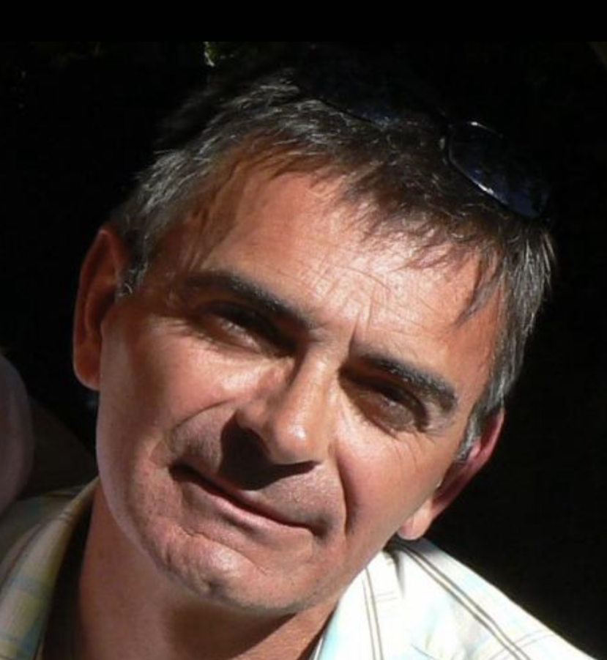
D D
General Note
2022-11-28
Notes:
c;0;Bull;Pat;2022-11-02;2022-11-28T18:04:21.903Z Hobbit 2022-11-28

Slide 24
D D
General Note
2022-11-28
Notes:
c;0;Bull;Pat;2022-11-02;2022-11-28T18:04:38.758Z Hobbit 2022-11-28

Slide 25
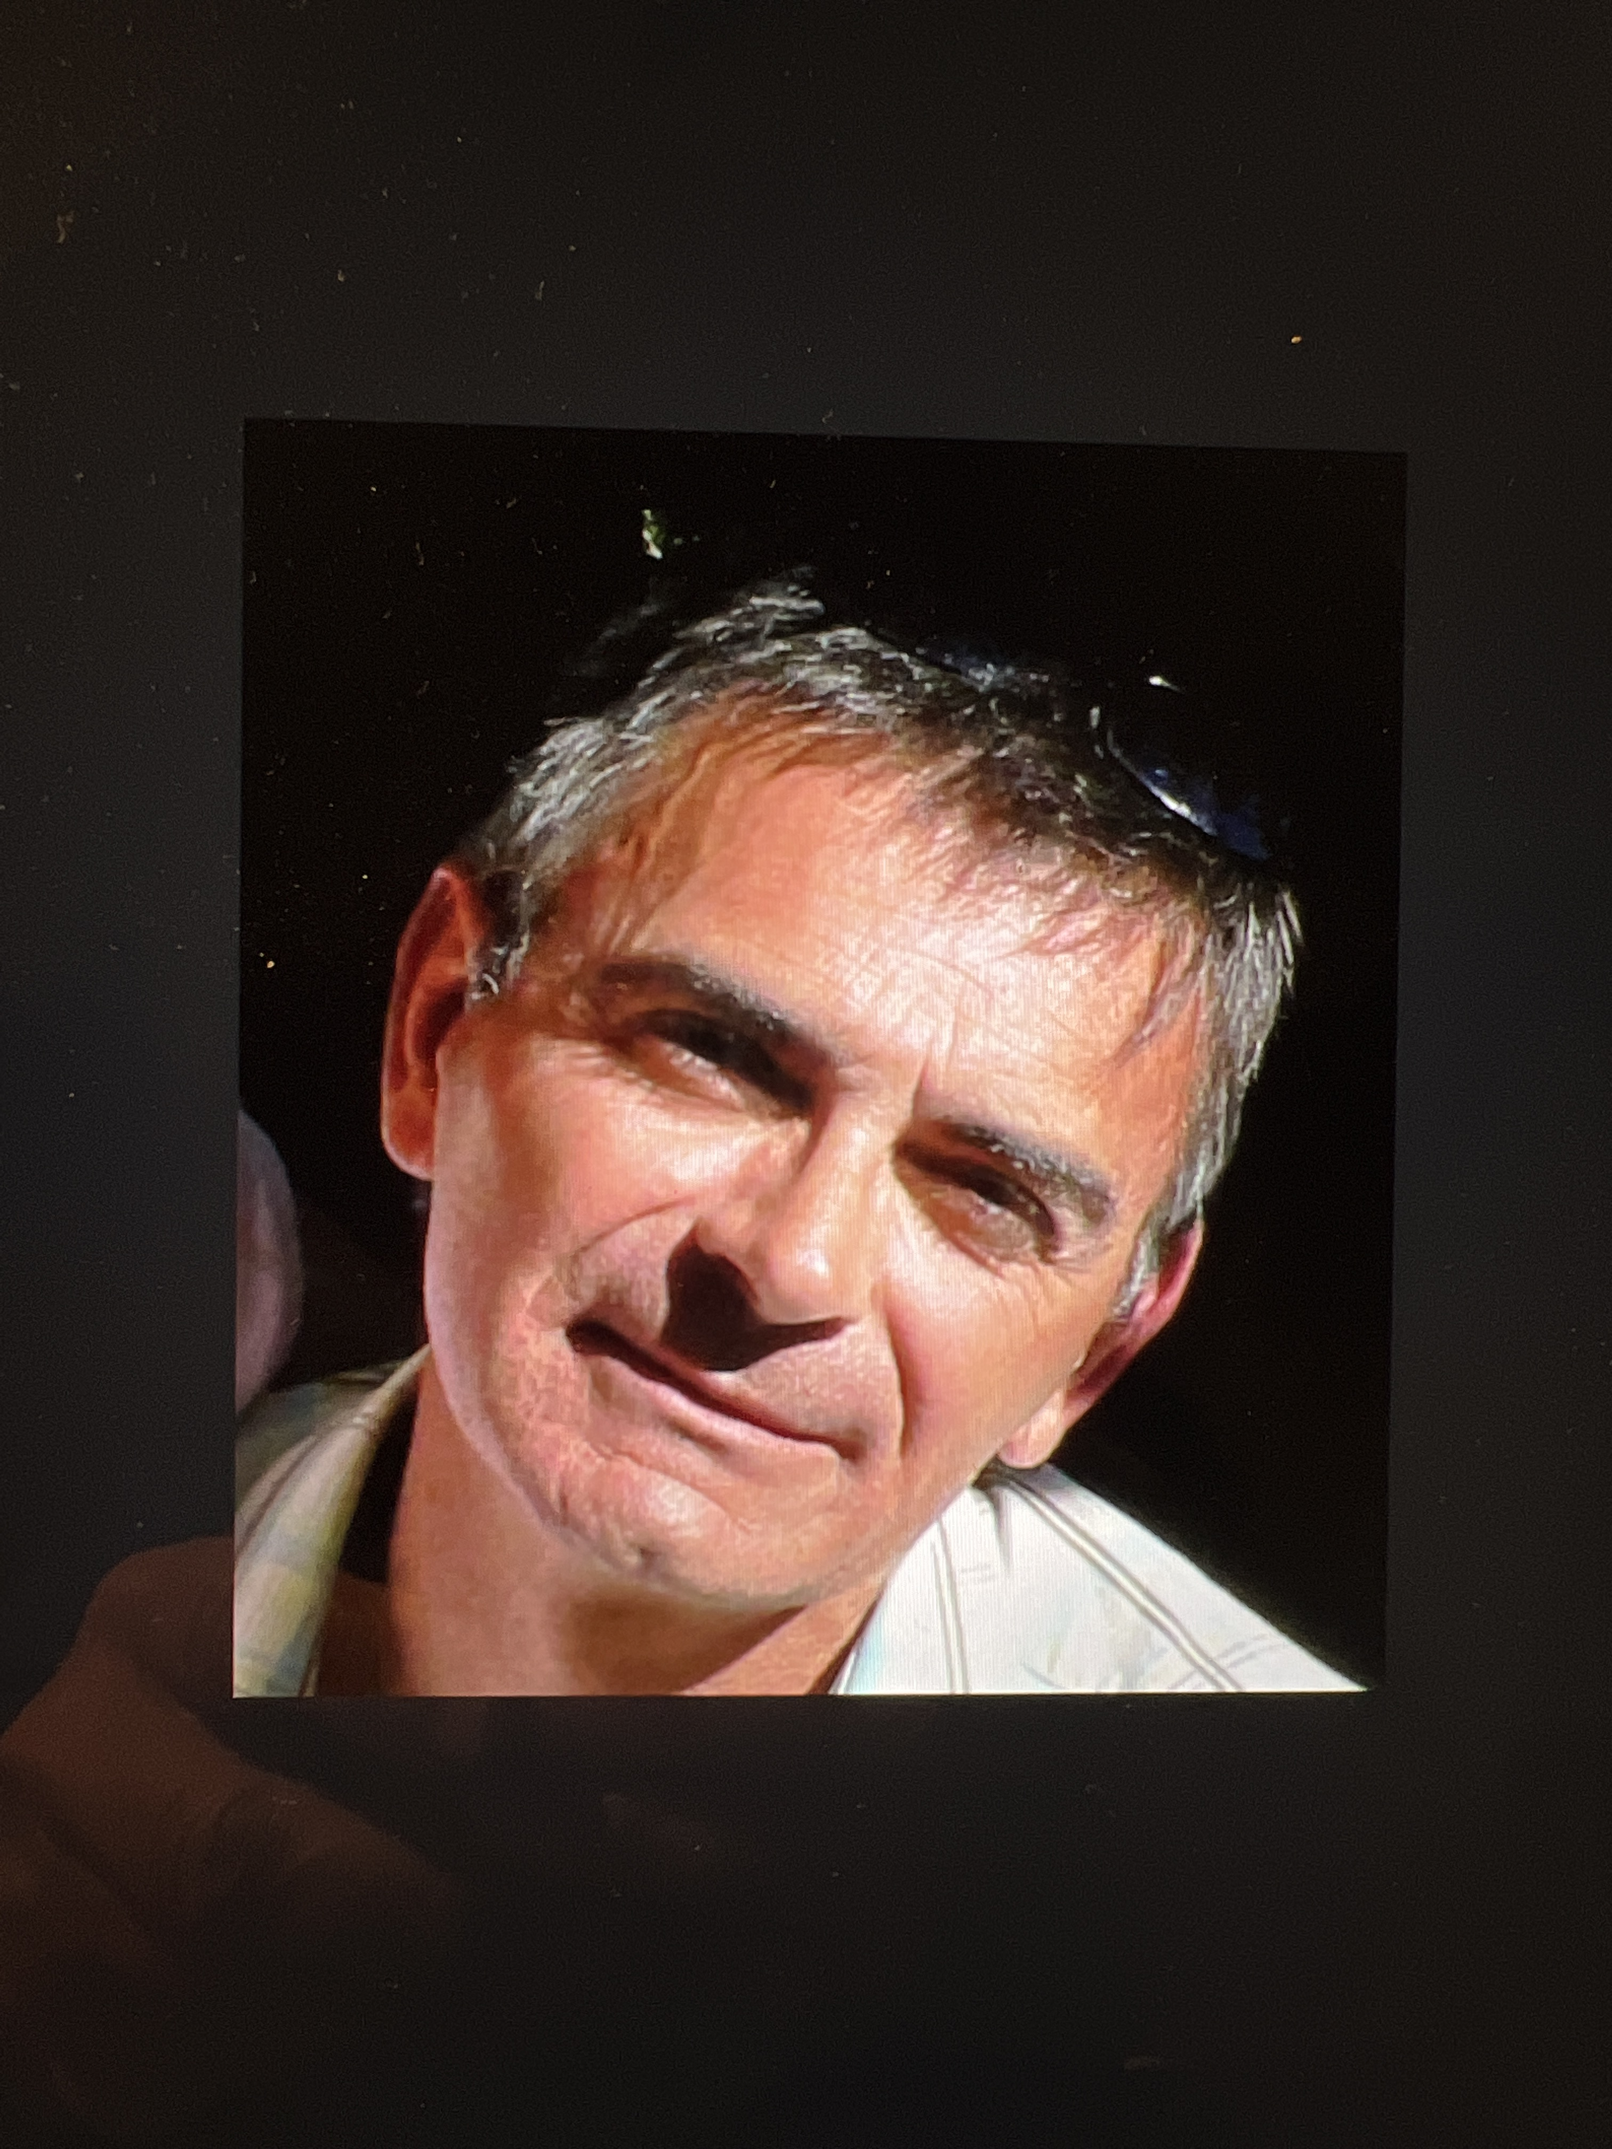
Dwarf Gimli
General Note
2022-11-28
Notes:
c;0;Bull;Pat;2022-11-02;2022-11-28T18:20:17.947Z Hobbit 2022-11-28

Slide 26
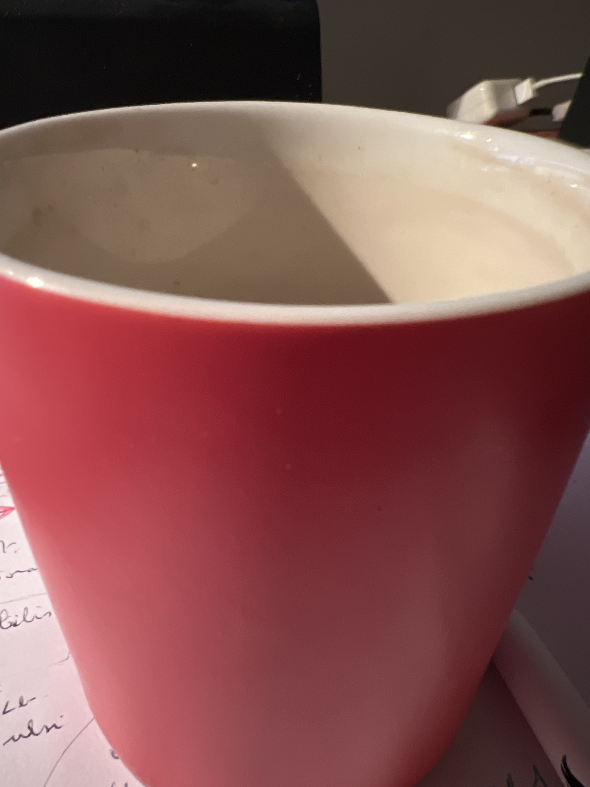
Dwarf Gimli
General Note
2022-11-28
Notes:
c;0;Bull;Pat;2022-11-02;2022-11-28T18:29:34.943Z Hobbit 2022-11-28

Slide 27
Dwarf Gimli
DOB: | 1001-01-01
Height:
Weight:
Sex: | M
Meds:
Allergies: | Succinyl Choline
Notes:
p;0;Gimli;Dwarf;1001-01-01 Paul

Slide 28
Dwarf Gimli
Operation
2023-08-14
Procedure: | Tonsillectomy
Complaint: | Snoring
Surgeon: | Gandolf
Equipment: | Staff
Notes:
Tonsillectomy o;0;Gimli;Dwarf;1001-01-01;2023-08-14T18:59:30.036Z Paul 2023-08-14

Slide 29
Dwarf Gimli
Pre Op Note
2023-08-14
Mallipati 7
Notes:
Mallipati 7 c;0;Gimli;Dwarf;1001-01-01;2023-08-14T20:15:24.564Z Paul 2023-08-14

Slide 30
Dwarf Gimli
General Note
2023-10-01
Test note
Notes:
Test note c;0;Gimli;Dwarf;1001-01-01;2023-10-01T02:42:34.267Z Paul 2023-10-01

Slide 31
Dwarf Gimli
Pre Op Note
2023-10-10
In the fictional world of Tolkien's Middle-earth, elves and dwarves are described as having distinct physiological characteristics. Here are some of the differences between elves and dwarves:
1. Height and Build: Elves are typically described as taller and more slender compared to dwarves. Dwarves, on the other hand, are generally shorter and more stoutly built.
2. Lifespan: Elves are known for their significantly longer lifespans compared to dwarves. Elves are immortal and can live for thousands of years, while dwarves have relatively shorter lifespans, commonly reaching a few hundred years.
3. Physical Abilities: Elves are often portrayed as more agile, graceful, and swift. They possess keen senses, exceptional eyesight, and acute hearing. Dwarves, on the other hand, are known for their great strength, endurance, and resilience, enabling them to endure arduous physical labor and excel in combat.
4. Resilience to Elements: Elves have a natural resistance to extreme temperatures and can withstand both extreme cold and heat with relative ease. Dwarves, on the other hand, have a natural affinity for underground environments and can better tolerate the dark and cramped conditions found in mines and caverns.
5. Facial Features: Elves are often described as having more ethereal and refined features, including delicate features, slender noses, and pointed ears. Dwarves typically have a more rugged and robust appearance, with broader facial features, stocky builds, and prominent beards.
It is important to note that these characteristics are specific to J.R.R. Tolkien's interpretation of elves and dwarves in his literary works. Different fictional universes or adaptations may depict elves and dwarves differently.
Notes:
In the fictional world of Tolkien's Middle-earth, elves and dwarves are described as having distinct physiological characteristics. Here are some of the differences between elves and dwarves: 1. Height and Build: Elves are typically described as taller and more slender compared to dwarves. Dwarves, on the other hand, are generally shorter and more stoutly built. 2. Lifespan: Elves are known for their significantly longer lifespans compared to dwarves. Elves are immortal and can live for thousands of years, while dwarves have relatively shorter lifespans, commonly reaching a few hundred years. 3. Physical Abilities: Elves are often portrayed as more agile, graceful, and swift. They possess keen senses, exceptional eyesight, and acute hearing. Dwarves, on the other hand, are known for their great strength, endurance, and resilience, enabling them to endure arduous physical labor and excel in combat. 4. Resilience to Elements: Elves have a natural resistance to extreme temperatures and can withstand both extreme cold and heat with relative ease. Dwarves, on the other hand, have a natural affinity for underground environments and can better tolerate the dark and cramped conditions found in mines and caverns. 5. Facial Features: Elves are often described as having more ethereal and refined features, including delicate features, slender noses, and pointed ears. Dwarves typically have a more rugged and robust appearance, with broader facial features, stocky builds, and prominent beards. It is important to note that these characteristics are specific to J.R.R. Tolkien's interpretation of elves and dwarves in his literary works. Different fictional universes or adaptations may depict elves and dwarves differently. c;0;Gimli;Dwarf;1001-01-01;2023-10-10T17:44:48.647Z Hobbit 2023-10-10

Slide 32
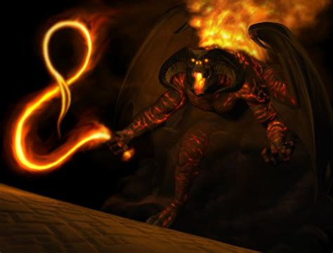
Boromir of Gondor
Pre Op Note
2023-08-29
Dwarves dwelve downward discovering devils
Notes:
Dwarves dwelve downward discovering devils c;0;Gimli;Dwarf;1001-01-01;2023-08-29T17:13:39.530Z Paul 2023-08-29

Slide 33
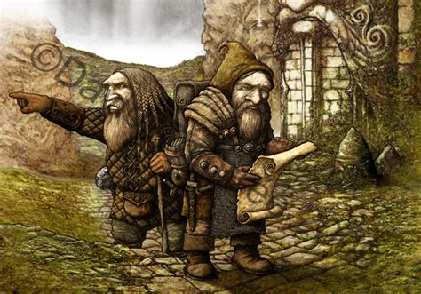
Boromir of Gondor
Pre Op Note
2023-09-24
Small but mighty!
Notes:
Small but mighty! c;0;Gimli;Dwarf;1001-01-01;2023-09-24T02:30:58.829Z Paul 2023-09-24

Slide 34
Boromir of Gondor
DOB: | 2978-10-12
Height:
Weight: | 70
Sex: | M
Meds:
Allergies:
Notes:
p;0;Gondor;Boromir;2022-03-17 Paul

Slide 35
Boromir of Gondor
Operation
3019-02-26
Procedure: | Fenetration
Complaint: | Horn cloven
Surgeon: | Orcs
Equipment: | Axes and Swords
Notes:
Fenetration o;0;Gondor;Boromir;2022-03-17;2022-03-26T01:50:07.328Z Paul 3019-02-26

Slide 36
Boromir of Gondor
General Note
2022-03-03
Notes:
c;0;Gondor;Boromir;2022-03-17;2022-03-03T04:58:05.803Z Paul 2022-03-03

Slide 37
Boromir of Gondor
General Note
2022-03-03
uploaded by paul
Notes:
uploaded by paul c;0;Gondor;Boromir;2022-03-17;2022-03-03T04:58:16.484Z Paul 2022-03-03

Slide 38
Boromir of Gondor
General Note
2022-03-03
Picture uploaded by paul
Notes:
Picture uploaded by paul c;0;Gondor;Boromir;2022-03-17;2022-03-03T04:58:39.061Z Paul 2022-03-03

Slide 39

White Shadowfax
General Note
2022-03-23
Notes:
c;0;Gondor;Boromir;2022-03-17;2022-03-23T17:34:14.265Z Paul 2022-03-23

Slide 40
White Shadowfax
General Note
2022-03-23
Notes:
c;0;Gondor;Boromir;2022-03-17;2022-03-23T17:34:14.270Z Paul 2022-03-23

Slide 41

White Shadowfax
Anesthesia Note
2023-09-29
Notes:
c;0;Gondor;Boromir;2022-03-17;2023-09-29T03:20:29.947Z Paul 2023-09-29

Slide 42
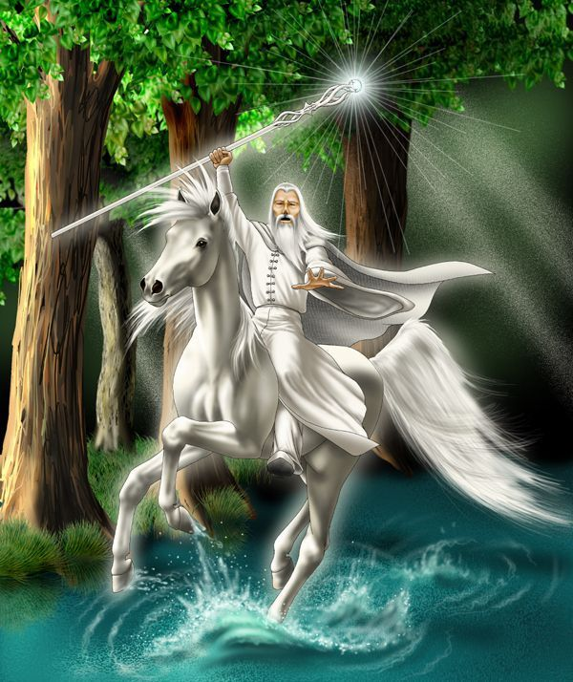
White Shadowfax
DOB: | 3018-01-01
Height:
Weight: | 1500
Sex: | M
Meds:
Allergies:
Notes:
p;0;Shadowfax;White;2020-03-05 Paul

Slide 43
White Shadowfax
Operation
2023-10-25
Procedure: | Shooing
Complaint:
Surgeon: | Ferrier
Equipment: | mallet
Notes:
Shooing o;0;Shadowfax;White;2020-03-05;2022-04-25T00:50:20.768Z Paul 2023-10-25

Slide 44
White Shadowfax
General Note
2022-04-17
test nore
Notes:
test nore c;0;Shadowfax;White;2020-03-05;2022-04-17T01:58:19.343Z Paul 2022-04-17

Slide 45
White Shadowfax
Surgery Note
2022-04-18
Add category
Notes:
Add category c;0;Shadowfax;White;2020-03-05;2022-04-18T18:17:21.577Z Paul 2022-04-18

Slide 46
White Shadowfax
General Note
2022-04-25
Given (reluctantly) by Theodin of the Rohan
Notes:
Given (reluctantly) by Theodin of the Rohan c;0;Shadowfax;White;2020-03-05;2022-04-25T00:51:54.262Z Paul 2022-04-25

Slide 47
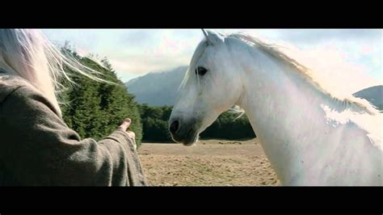
Dragon Smaug
Anesthesia Note
2022-03-29
Notes:
c;0;Shadowfax;White;2020-03-05;2022-03-29T18:35:43.997Z Paul 2022-03-29

Slide 48
Dragon Smaug
General Note
2022-03-29
Gandolf's ride
Notes:
Gandolf's ride c;0;Shadowfax;White;2020-03-05;2022-03-29T18:35:44.000Z Paul 2022-03-29

Slide 49
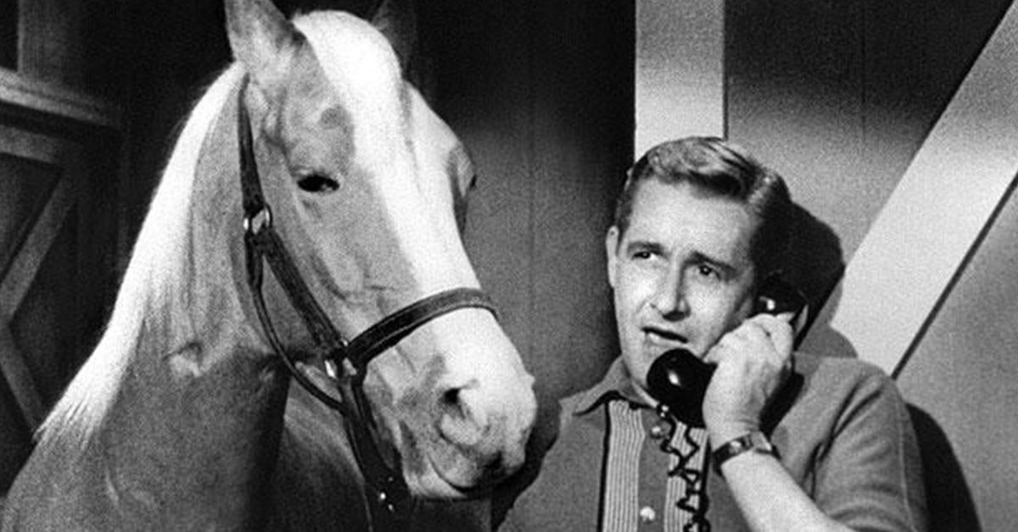
Dragon Smaug
General Note
2022-04-11
Wrong horse
Notes:
Wrong horse c;0;Shadowfax;White;2020-03-05;2022-04-11T20:29:43.679Z Paul 2022-04-11

Slide 50
Dragon Smaug
Anesthesia Note
2022-04-17
Chief of the Mearas
Notes:
Chief of the Mearas c;0;Shadowfax;White;2020-03-05;2022-04-17T01:58:33.879Z Paul 2022-04-17

Slide 51
Dragon Smaug
DOB: | 1922-03-08
Height:
Weight:
Sex:
Meds:
Allergies:
Notes:
p;0;Smaug;Dragon;1922-03-08 Paul

Slide 52
Dragon Smaug
Operation
2023-03-06
Procedure: | descaling
Complaint: | Gastric pain
Surgeon: | hyper elf
Equipment: | arrow
Notes:
descaling o;0;Smaug;Dragon;1922-03-08;2022-03-27T22:10:22.822Z Paul 2023-03-06

Slide 53
Dragon Smaug
General Note
2022-03-13
Bad Dragon!
Notes:
Bad Dragon! c;0;Smaug;Dragon;1922-03-08;2022-03-13T02:56:23.924Z Paul 2022-03-13

Slide 54
Dragon Smaug
General Note
2023-04-29
Cheesy CGI.
Notes:
Cheesy CGI. c;0;Smaug;Dragon;1922-03-08;2023-04-29T23:16:12.049Z Paul 2023-04-29

Slide 55
Bombadil Tom
DOB: | 1934-04-15
Height:
Weight:
Sex:
Meds:
Allergies:
Notes:
p;0;Tom;Bombadil;1934-04-15 Paul

Slide 56
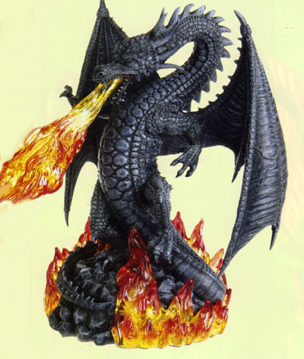
Elrond of Rivendell
Pre Op Note
2022-06-18
Esphageal discomfort
Notes:
Esphageal discomfort c;0;Smaug;Dragon;1922-03-08;2022-06-18T12:14:40.925Z Paul 2022-06-18

Slide 57
Elrond of Rivendell
DOB: | 0532-01-01
Height:
Weight: | 70
Sex: | M
Meds:
Allergies:
Notes:
p;0;of Rivendell;Elrond;2022-03-22 Paul

Slide 58
Elrond of Rivendell
Operation
2022-04-19
Procedure: | "Spock" revision
Complaint: | Hearing loss
Surgeon: | Bones
Equipment: | tricorder
Notes:
"Spock" revision o;0;of Rivendell;Elrond;2022-03-22;2022-04-19T20:00:50.392Z Paul 2022-04-19

Slide 59
Orc Gulfimbul
DOB: | 2023-08-02
Height:
Weight:
Sex:
Meds:
Allergies:
Notes:
p;0;test;two;2023-08-02 Paul

Slide 60
Orc Gulfimbul
Operation
2023-08-12
Procedure: | Dressing
Complaint: | Yup, some complaints
Surgeon: | Orcs
Equipment:
Notes:
Dressing o;0;test;two;2023-08-02;2023-08-12T01:08:13.011Z Paul 2023-08-12

Slide 61
Orc Gulfimbul
General Note
2023-08-12
author:Paul type:patient LastName:test FirstName:one DOB:2023-08-01 patient_id:p;0;test;one;2023-08-01
Notes:
author:Paul type:patient LastName:test FirstName:one DOB:2023-08-01 patient_id:p;0;test;one;2023-08-01 c;0;test;two;2023-08-02;2023-08-12T01:04:27.414Z Paul 2023-08-12

Slide 62
Orc Gulfimbul
Pre Op Note
2023-08-12
yup
Notes:
yup c;0;test;two;2023-08-02;2023-08-12T01:07:22.588Z Paul 2023-08-12

Slide 63
Orc Gulfimbul
Pre Op Note
2023-08-12
second note
Notes:
second note c;0;test;two;2023-08-02;2023-08-12T01:07:47.251Z Paul 2023-08-12

Slide 64
Orc Gulfimbul
Pre Op Note
2023-10-10
In J.R.R. Tolkien's works, the color of orc blood is not explicitly mentioned. Tolkien did not extensively describe the physical characteristics of orcs, including the color of their blood. As a result, the color of orc blood is left to speculation and interpretation.
Given that orcs are generally portrayed as dark and sinister creatures, one might imagine their blood to be similarly dark, perhaps a deep red or even black. However, without specific information from the source material, the exact color of orc blood remains open to personal interpretation and creative imagination.
Notes:
In J.R.R. Tolkien's works, the color of orc blood is not explicitly mentioned. Tolkien did not extensively describe the physical characteristics of orcs, including the color of their blood. As a result, the color of orc blood is left to speculation and interpretation. Given that orcs are generally portrayed as dark and sinister creatures, one might imagine their blood to be similarly dark, perhaps a deep red or even black. However, without specific information from the source material, the exact color of orc blood remains open to personal interpretation and creative imagination. c;0;test;two;2023-08-02;2023-10-10T17:53:32.723Z Hobbit 2023-10-10

Slide 65
Orc Gulfimbul
General Note
2022-03-03
Notes:
c;0;of Rivendell;Elrond;2022-03-22;2022-03-03T14:04:10.544Z Paul 2022-03-03

Slide 66
Orc Gulfimbul
General Note
2022-03-03
Notes:
c;0;of Rivendell;Elrond;2022-03-22;2022-03-03T14:04:21.662Z Paul 2022-03-03

Slide 67
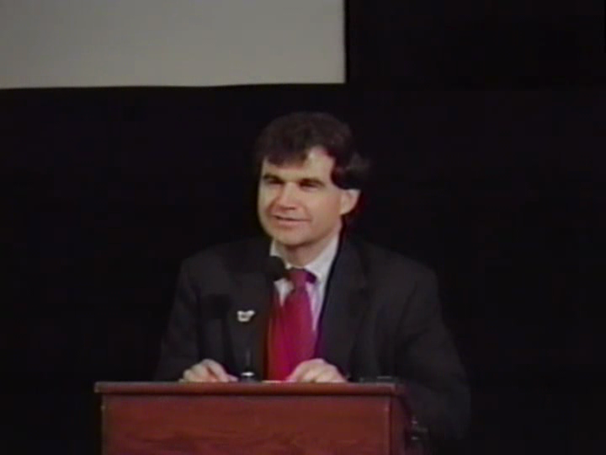
Gandolf the Grey (Olórin)
General Note
2023-08-12
author:Paul type:patient LastName:test FirstName:three DOB:2023-08-31 patient_id:p;0;test;three;2023-08-31 email: phone: Address: Contact:
Notes:
author:Paul type:patient LastName:test FirstName:three DOB:2023-08-31 patient_id:p;0;test;three;2023-08-31 email: phone: Address: Contact: c;0;test;two;2023-08-02;2023-08-12T01:09:12.012Z Paul 2023-08-12

Slide 68
Gandolf the Grey (Olórin)
DOB: | 2014-03-12
Height:
Weight:
Sex:
Meds:
Allergies:
Notes:
p;0;the Grey (Olórin);Gandolf;2014-03-12 Paul

